Slide 1
Present a green home Project
You and your partner are architects. You are going to design and present an eco-friendly house.
A. Think about the house. Work with a partner. Answer the questions below.
1. What kind of house is it: a tree house, an underground house, a tiny house, a container house, a suburban house, an apartment, or something else?
2. How is the home eco-friendly? Use two or three ideas in your home.
It has solar panels. It has a vegetable garden. It recycles water.
It’s small. It has big windows for natural light. ___________
B. Design the house. Work in pairs. Draw a floor plan for the green house. Use the information in A.

Slide 2
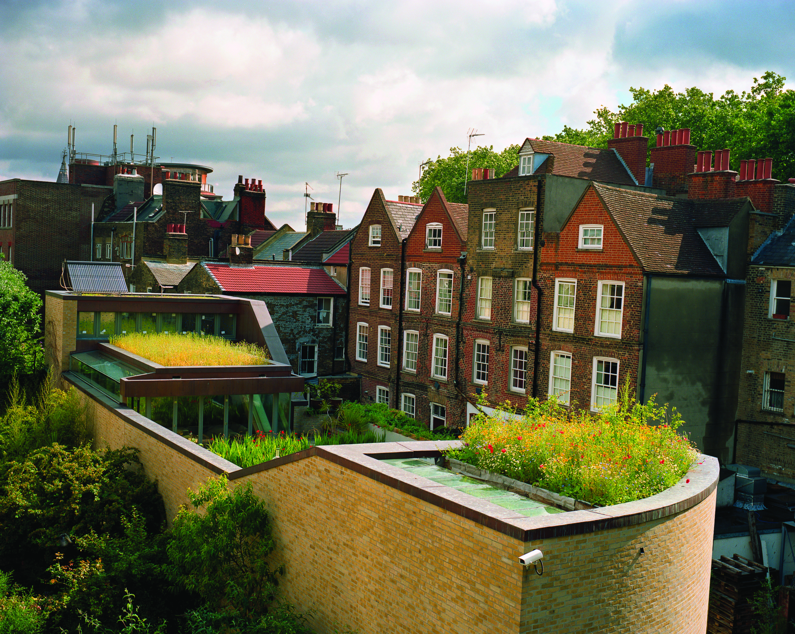
Present a green home Project
C. Present your plan. Work with two other pairs. Take turns explaining your design to the others. Tell them how your house is green.
D. Choose a plan. In your group of six, choose the best plan.
A green roof decreases
energy costs for this house
in London, England.

Slide 3
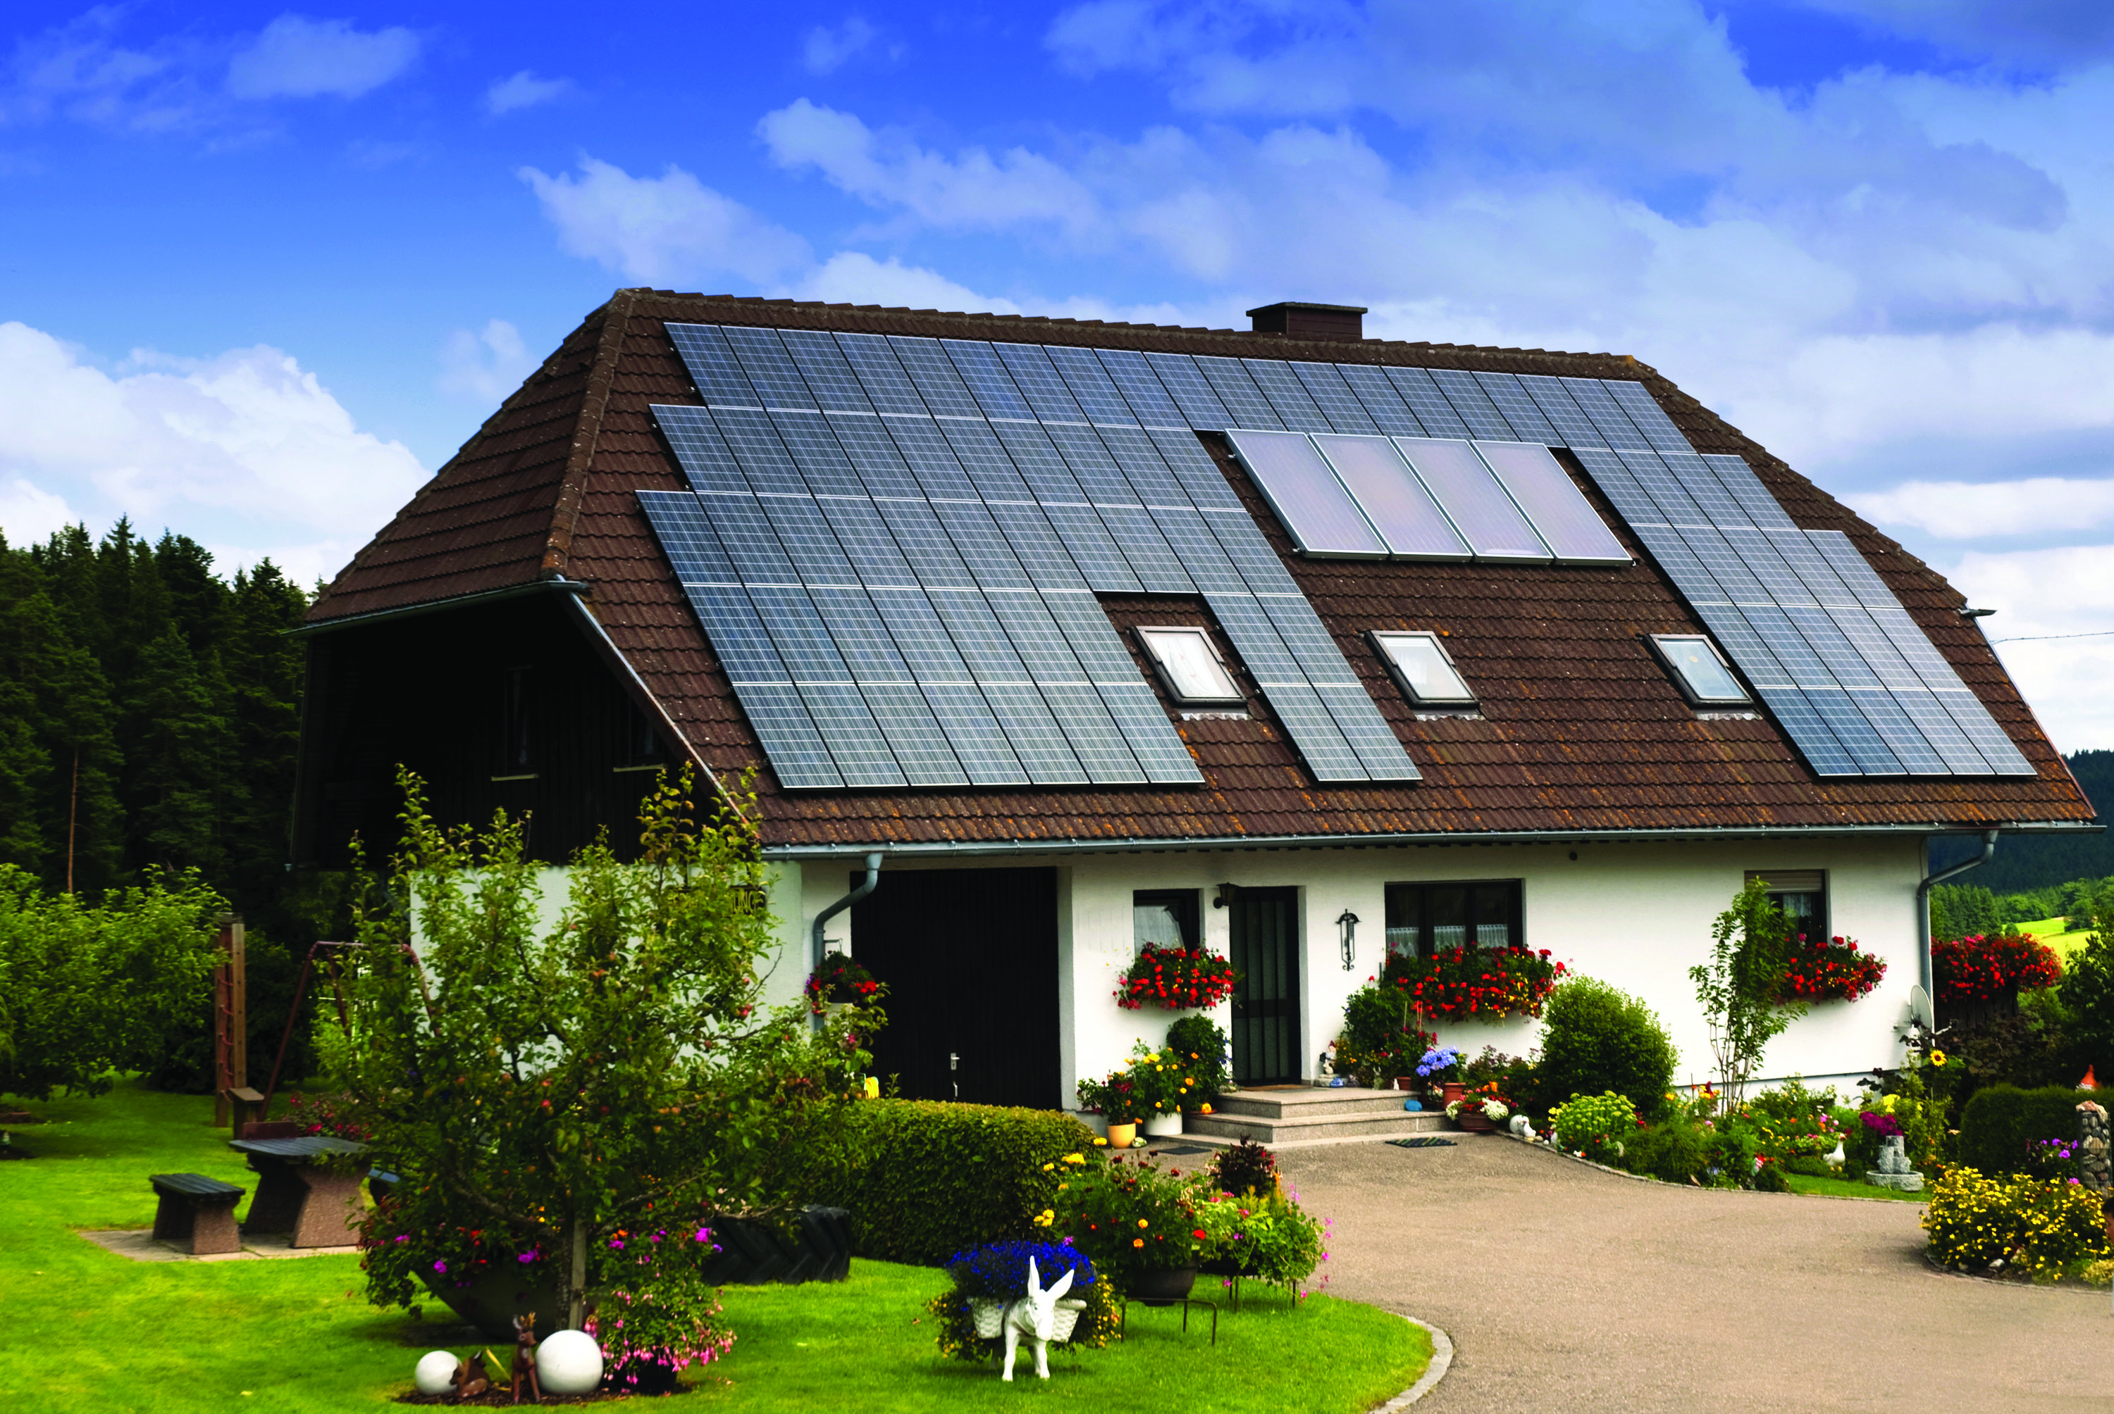
Present a green home Project
Design a home for your friend. Interview your friend or classmate about his or her dream home (e.g. Where is it? How many rooms are there?). Draw the floor plan. Explain your plan to the class.

